Slide 1
Going deeper with convolutions

Slide 2

What is Inception?
A deep convolutional neural network architecture codenamed Inception which was responsible for setting the new state of the art for classification and detection in the ImageNet Large-Scale Visual Recognition Challenge 2014 (ILSVRC14)
The purpose of this architecture is to increasing the depth and width of the network while keeping the computational budget constant.

Slide 3
What makes a deep convolutional neural network perform better?
more powerful hardware
larger datasets
bigger models
efficiency matters. prioritizes resource utilization over accuracy. (reasonable cost)
new ideas, algorithms and improved network architectures ex : GoogLeNet submission to ILSVRC 2014 actually uses 12× fewer parameters than the winning architecture of Krizhevsky from 2012, while being significantly more accurate.

Slide 4
All filters in the Inception model are learned
Instead of using a pre-defined filter, the model starts with random values in its filters. During training, these values are adjusted through backpropagation to minimize the loss.
As the model trains, these values are updated to capture patterns in the data
Inception layers are repeated many times, leading to a 22-layer deep model in the case of the GoogLeNet model

Slide 5
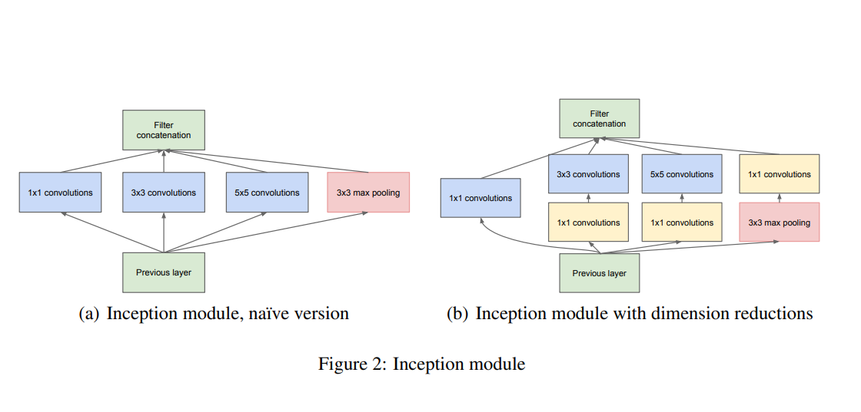
Inception Module
Naive version of inception module is as good as the one with dimensionally reduction but the cost is lower.
As these “Inception modules” are stacked on top of each other, their output correlation statistics are bound to vary: as features of higher abstraction are captured by higher layers, their spatial concentration is expected to decrease suggesting that the ratio of 3×3 and 5×5 convolutions should increase as we move to higher layers

Slide 6
Network-in-Network approach
When applied to convolutional layers, the method could be viewed as additional 1×1 convolutional layers followed typically by the rectified linear activation.
It remove computational bottlenecks, that would otherwise limit the size of our networks.
In 1x1 convolutions are used to perform channel-wise dimensionality reduction. This allows for not just increasing the depth, but also the width of our networks without significant performance penalty. By doing this, it reduces computational costs
It reduces the number of parameters in the network, especially when replacing fully connected layers, leading to faster training and potentially better generalization.

Slide 7
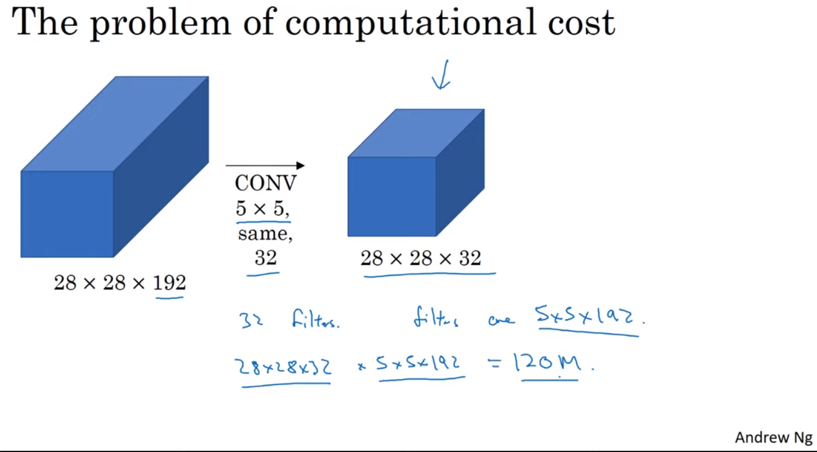
Cost of a 5x5 convolution

Slide 8
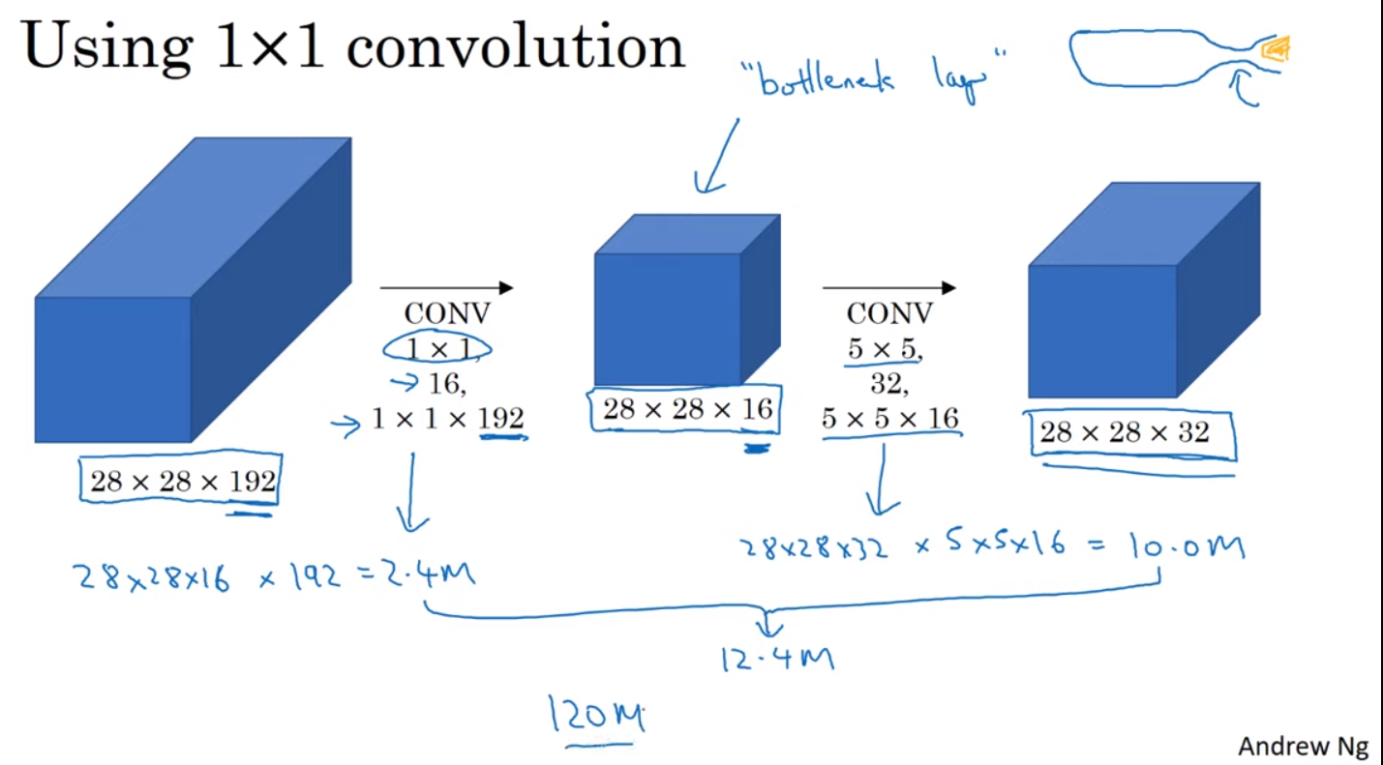
Cost of a 5x5 convolution after 1x1 convolution

Slide 9
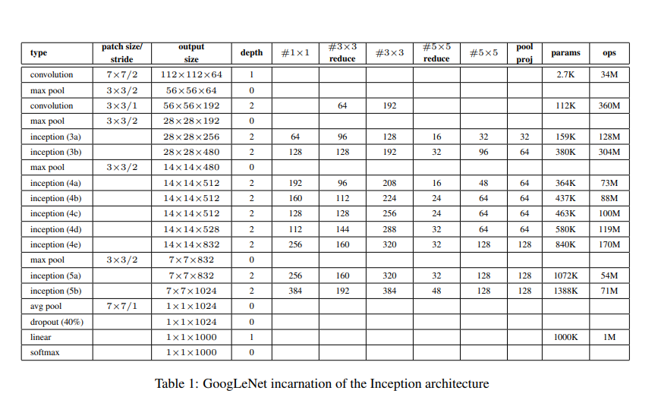
GoogLeNet
The team-name chosen in the ILSVRC14 competition

Slide 10
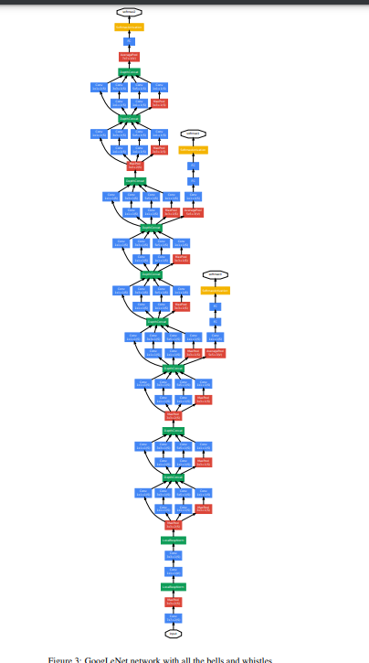

Slide 11
All the convolutions, including those inside the Inception modules, use rectified linear activation.
The size of the receptive field in our network is 224×224 taking RGB color channels.
“#3×3 reduce” and “#5×5 reduce” stands for the number of 1×1 filters in the reduction layer used before the 3×3 and 5×5 convolutions.
The network is 22 layers deep when counting only layers with parameters (or 27 layers if we also count pooling).
The overall number of layers (independent building blocks) used for the construction of the network is about 100.

Slide 12
Training Methodology
used the DistBelief ( in 2014 for the competition. I used PyTorch)
used asynchronous stochastic gradient descent with 0.9 momentum, fixed learning rate schedule (decreasing the learning rate by 4% every 8 epochs)
Polyak averaging was used to create the final model used at inference time.

